Slide 1
XPath
Language for retrieving information from a XML document.

Slide 2
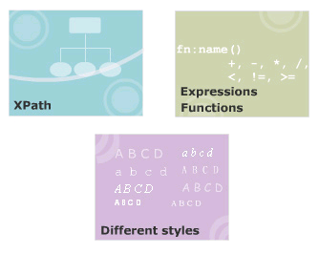
Module Introduction
Welcome to the module, More on XSLT.
Understanding on XPath, and identifying the various nodes of XPath.
Lists the different operators used with XPath and describes the various XPath expressions and functions.
Explains how to switch between styles and how to transform XML documents into HTML using XSLT.
In this module, you will learn about:
  Xpath
  XPath Expressions and Functions
  Working with different styles

Slide 3
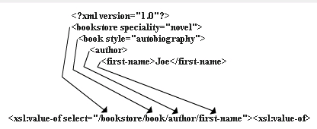
XPath
Language for retrieving information from a XML document.
Use to navigate through elements and attributes in an XML document.
Allows identifying parts of an XML document.
Provides a common syntax shared by XSLT and XQuery.
  XSLT
  XQuery: language for extracting information from XML documents

Slide 4
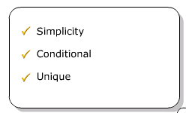
Benefits of XPath
Syntax is simple for the simple and common cases.
Any path that can occur in an XML document and any set of conditions for the nodes in the path can be specified.
Any node in an XML document can be uniquely identified.
XPath is designed to be used in many contexts.
Applicable to providing links to nodes, for searching repositories, and for many other applications.

Slide 5
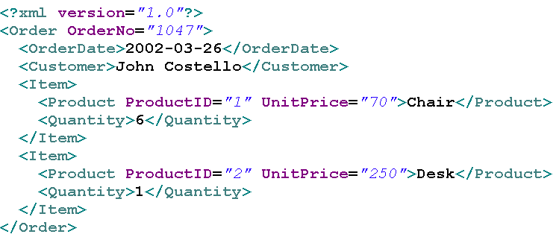
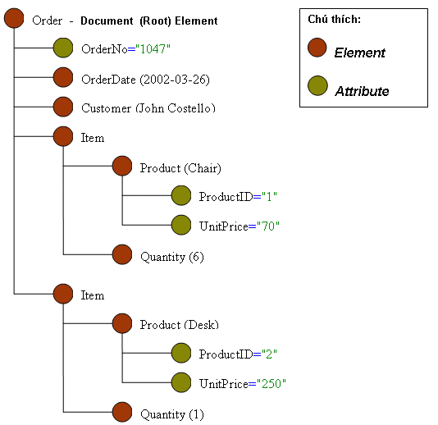
XPath Tree Example

Slide 6
Operators in XPath
XPath provides:
  Basic floating point arithmetic operators (+, -,*, div, mod)
  Comparison and Boolean operators. (<=, <, >=, > =, !=, and, or)

Slide 7
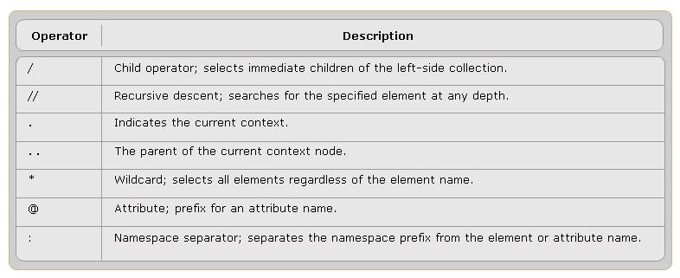
XPath expressions
Can returns: a node set, a boolean, a string, a number.
Are constructed using the operators and special characters

Slide 8
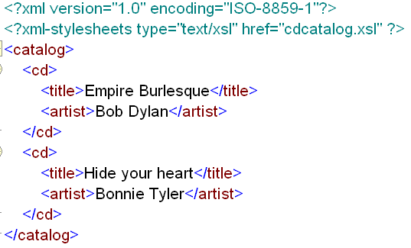
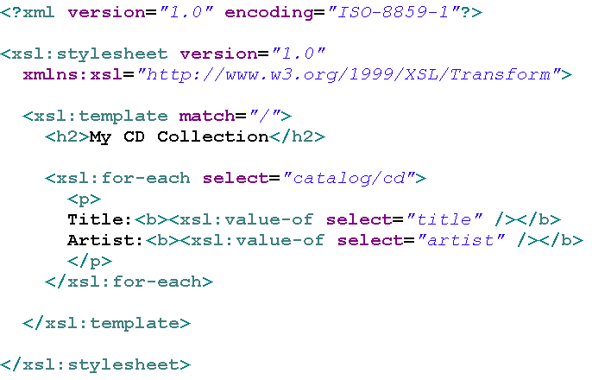
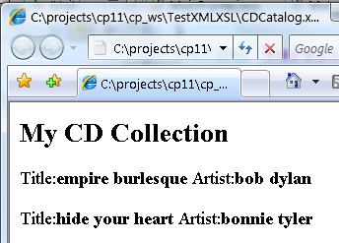
Examples of XPath Operators
xsl document
xml document
output

Slide 9
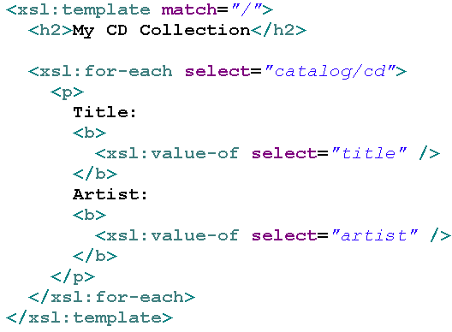
Types of Matching
Matching by name
Matching by ancestry
Matching the element names
Matching the root
Matching by attribute

Slide 10
Xpath core functions
Node Set Functions
String Functions
Boolean Functions
Number Functions

Slide 11
@1 - Node Set Functions
Return value | Function name
number | last()
number | position()
number | count(node-set)
node-set | id(object)
string | local-name(node-set?)
string | namespace-uri(node-set?)
string | name(node-set?)

Slide 12
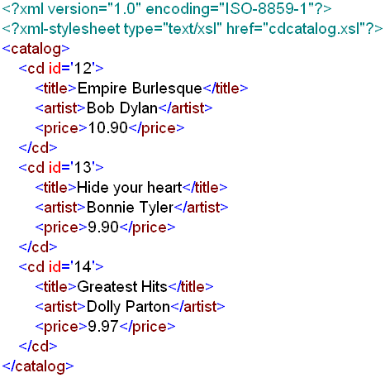
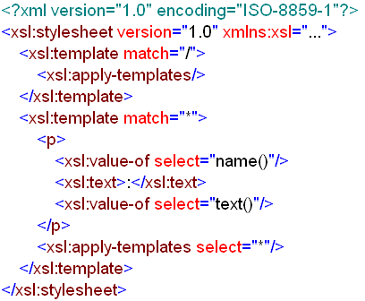
Example of Node Set Functions
xml document
xsl document

Slide 13
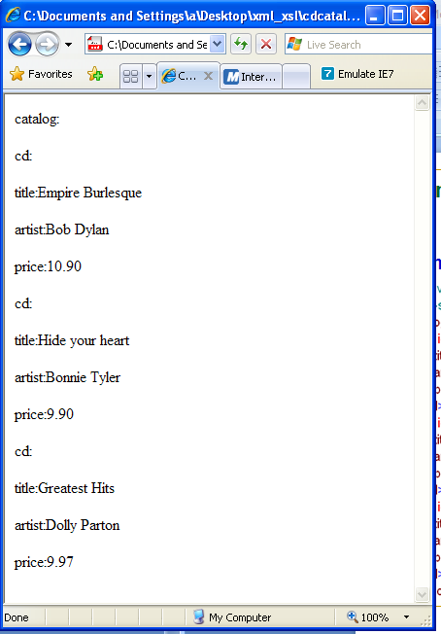
Output of Example of Node Set Functions

Slide 14
@2 - String Functions
Return value | Function name
string | string(object?)
string | concat(string, string, string*)
boolean | starts-with(string, string)
boolean | contains(string, string)
string | substring-before(string, string)
string | substring-after(string, string)
string | substring(string, number, number?)
number | string-length(string?)
string | normalize-space(string?)
string | translate(string, string, string)

Slide 15
@3 - Boolean Functions
Return value | Function name
boolean | boolean(object)
boolean | not(object)
boolean | true()
boolean | false()
boolean | lang(string)

Slide 16
@4 - Number Functions
Return value | Function name
number | number(object?)
number | sum(node-set)
number | floor(number)
number | ceiling(number)
number | round(number)

Slide 17
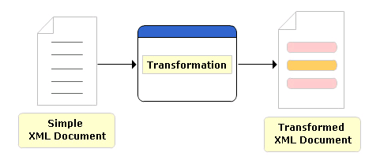
Transforming XML using XSLT
Step 1: Creating a normal XML document:
  <?xml version="1.0" encoding="UTF-8"?>
Step 2: Create an XSL stylesheet:
  <?xml version="1.0" encoding="ISO-88S9-l"?>
  <xsl:stylesheet xmlns:xsl="http://www.w3.org/1999/XSL/Transform" version="l.D“>
  …….
  </xsl:stylesheet>
Step 3: Set it up to produce HTML-compatible output:
  <xsl:stylesheet>
    <xsl:output method="html"/>
    …
  </xsl:stylesheet>

Slide 18
That’s about all for today!
XPath
XPath Expressions and Functions
Working with different styles
Thank you all for your attention and patient !

